Slide 1
Internet Access and Infrastructure related issues

Slide 2
Internet Access and Infrastructure related issues
Internet connection speeds in Nepal in 2022
Data published by Ookla indicate that internet users in Nepal could have expected the following internet connection speeds at the start of 2022:
Median mobile internet connection speed via cellular networks: 18.42 Mbps.
Median fixed internet connection speed: 28.32 Mbps.
Ookla’s data reveals that the median mobile internet connection speed in Nepal increased by 5.13 Mbps (+38.6 percent) in the twelve months to the start of 2022.
Meanwhile, Ookla’s data shows that fixed internet connection speeds in Nepal increased by 8.36 Mbps (+41.9 percent) during the same period.

Slide 3
Internet Access and Infrastructure related issues
Social media statistics for Nepal in 2022
There were 13.70 million social media users in Nepal in January 2022.
The number of social media users in Nepal at the start of 2022 was equivalent to 45.7 percent of the total population, but it’s important to note that social media users may not represent unique individuals (see our detailed notes on data to learn why).
Kepios analysis reveals that social media users in Nepal increased by 700 thousand (+5.4 percent) between 2021 and 2022.
Data from GSMA Intelligence shows that there were 40.58 million cellular mobile connections in Nepal at the start of 2022.

Slide 4
Internet Access and Infrastructure related issues
Facebook had 12.30 million users in Nepal in early 2022.
Instagram had 2.30 million users in Nepal in early 2022.
Facebook Messenger reached 9.60 million users in Nepal in early 2022.
LinkedIn had 1.00 million “members” in Nepal in early 2022.
Twitter had 417.9 thousand users in Nepal in early 2022.

Slide 5
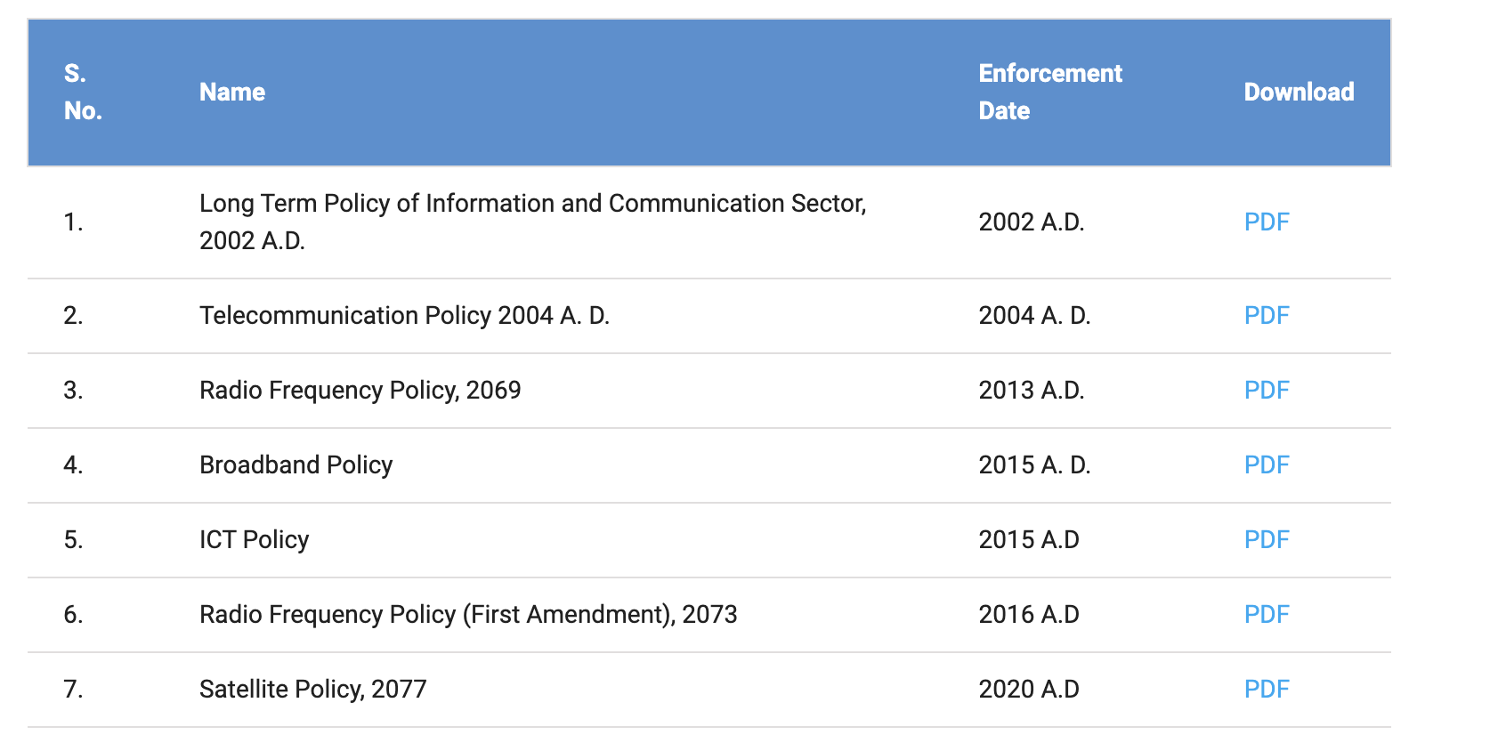
Telecom policy

Slide 6
Telecom policy

Slide 7
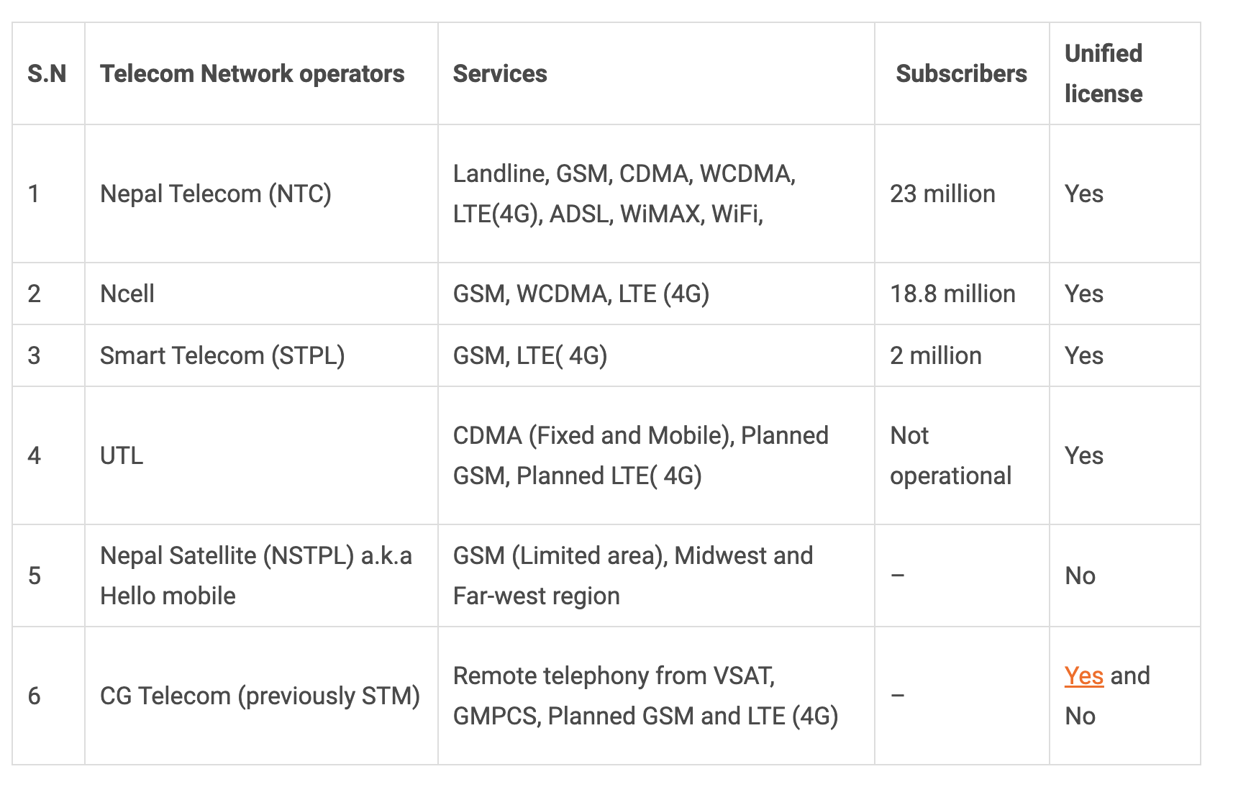
Telecom infrastructure

Slide 8
Telecom infrastructure

Slide 9
ISP's
Nepal’s 8 most popular internet service providers (ISPs)
Worldlink Communications
Vianet Communications Pvt Ltd
Subisu Cablenet Pvt Ltd
Classic Tech
Nepal Telecom
NetMax
DishHome Fiber Net
CG Net

Slide 10
Issues impinging upon ICT penetration and uptake in the country
The successful use of ICT in these various sectors will require a high degree of emphasis on implementation. The Government of Nepal needs to focus on the following priority areas to create an enabling environment: Technology and Infrastructure development, entrepreneurship/PPP so that private organizations would involve in every sector, talent, and skills development so that country will get the skilled technical workforce to implement the efficient use of ICT. Encourage private sector participation, improve professional education, facilitate the event of a robust financial ecosystem, encourage foreign direct investment in priority areas, making public servants digitally-ready will be essential. Emerging business models and disruptive technologies such as artificial intelligence (AI), robotics, the Internet of things (IoT) and over the top (OTT) are transforming the way work is done. These emerging technologies are allowing governments and enterprises globally to unlock the potential to achieve exponential growth.

Slide 11
Issues impinging upon ICT penetration and uptake in the country
Several policies and regulatory frameworks governing the ICT sector provide a necessary foundation for the technology-friendly Nepal. The National ICT Policy, introduced in 2015, seeks to enhance the vision of transforming Nepali society into knowledge and information-based society by harnessing rapid advances in the ICT sector. Similarly, the National Broadband Policy announced in 2016 puts forth a framework for stimulating broadband access and availability across the country. Along with the national broadcasting act and regulation, radio act and radio communication license regulation are critical frames for the development of the ICT sectors.
There could be a need to revisit investment and trade policies to secure large scale private sector participation in various sectors within the digital economy, such as (e-commerce, sharing economy, and IT-enabled services). Similarly, it will be essential to carry out a broad-based policy gap analysis to ensure that the ICT sector is grounded on sound policy frameworks. It is necessary to incorporate the use of emerging technology in regulation to get the best out of the ICT. The ICT sector must be assessed and evaluated regularly with a public and private partner for endorsing automation and digitalization and suggest improvements if necessary.

Slide 12
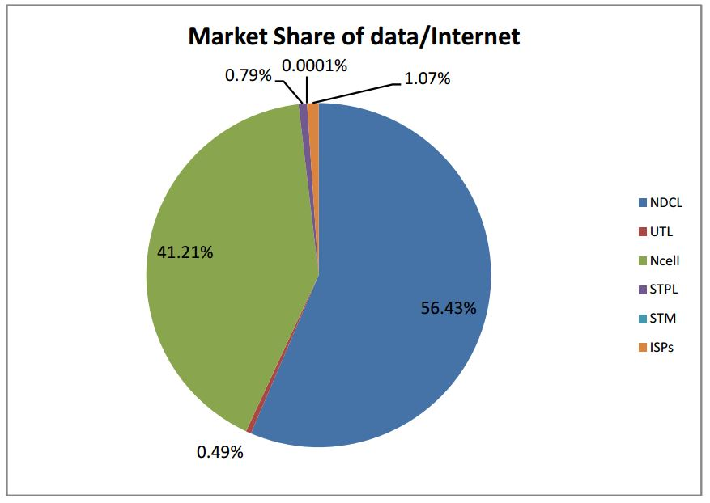
Issues impinging upon ICT penetration and uptake in the country

Slide 13
https://datareportal.com/reports/digital-2022-nepal#:~:text=Nepal's%20internet%20penetration%20rate%20stood,percent)%20between%202021%20and%202022.
https://nta.gov.np/en/policies/
https://www.nepalitelecom.com/2017/01/telecom-operators-nepal-operator-sim-card-buy-choose.html
https://dhulikhelmun.gov.np/sites/dhulikhelmun.gov.np/files/documents/ICT%20policy%20Nepal.pdf
https://ictframe.com/opportunities-and-challenges-to-use-ict-in-nepal/

